Slide 1

Speculative Biodesign 1:
Bioluminescence
Samuel Walinsky

Slide 2

Ostracods as Radioactivity Monitors
Bioluminescent indication of radiation

Slide 3

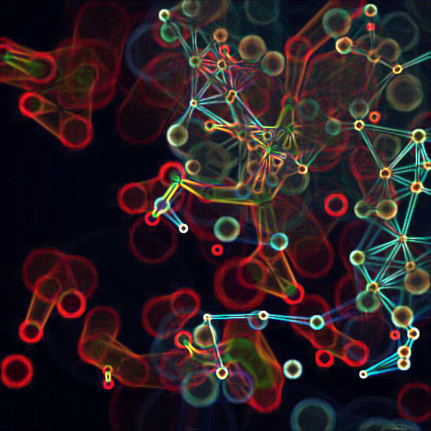

Design Statement
I propose the usage of groups of ostracods in “families” through a biomimetic synergy-type relationship around specific nuclear fallout sites. Semi-permeable membrane housing tubes would be manufactured to contain the groups of ostracods in order to be reactive to the environment and localized around a radioactive fallout site. Bioluminescence of the ostracods during mating dance would be used to determine safe levels of radioactivity present in the ocean, and when the bioluminescence is no longer visible the ostracods have died due to high levels of radiation.

Slide 4
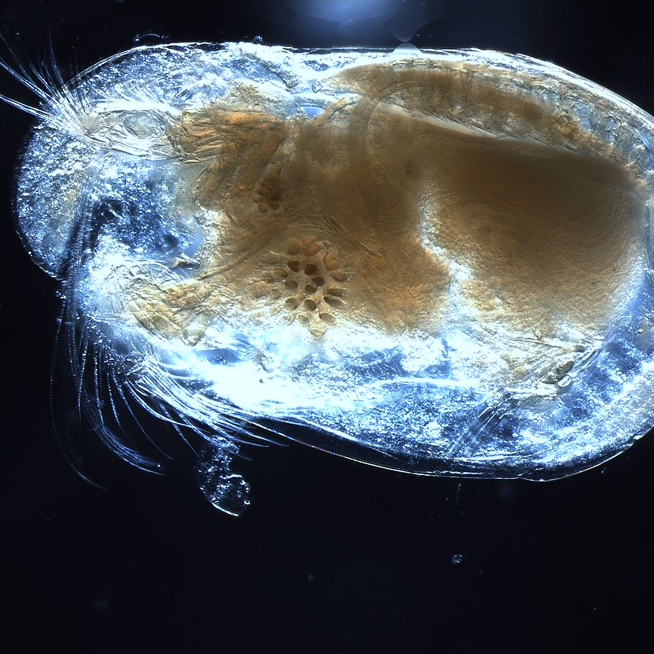
Ostracods!
Miniature Warning lights
Males illuminate when doing their mating “dance” to attract females
Bioluminescence only occurs in live organisms

Slide 5
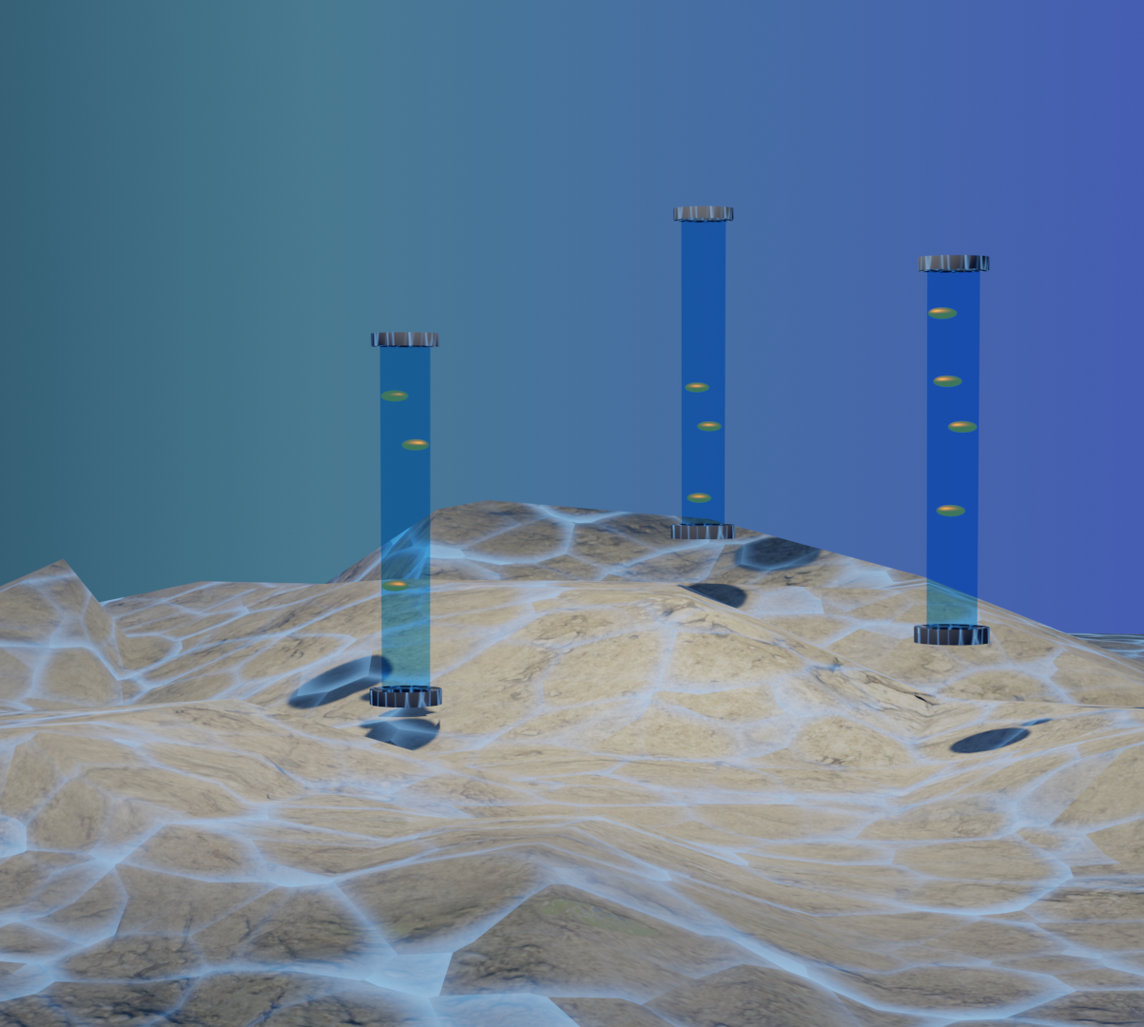
Radioactive Indicators
Visualization
Semi-permeable housing tubes that hold bundles of ostracod “families” made from silicon membrane
Illuminate when mating
Indicate radioactivity levels in their environments through their presence (or lack thereof)

Slide 6
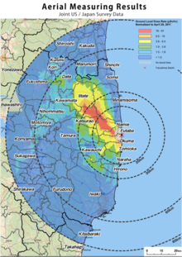
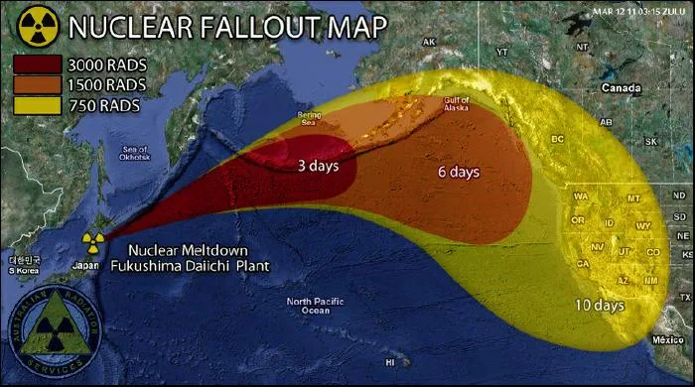
Implementation and Feasibility
Fukushima Disaster
Housing Sites along North American Pacific Coastline

Slide 7

Links
https://hakaimagazine.com/features/secret-history-bioluminescence/
https://www.bgs.ac.uk/discovering-geology/fossils-and-geological-time/ostracods/
https://ocean.si.edu/ocean-life/invertebrates/you-light-my-world#:~:text=Luminescent%20ostracods%20can%20use%20light,spotted%20by%20their%20own%20predators.

